Slide 1
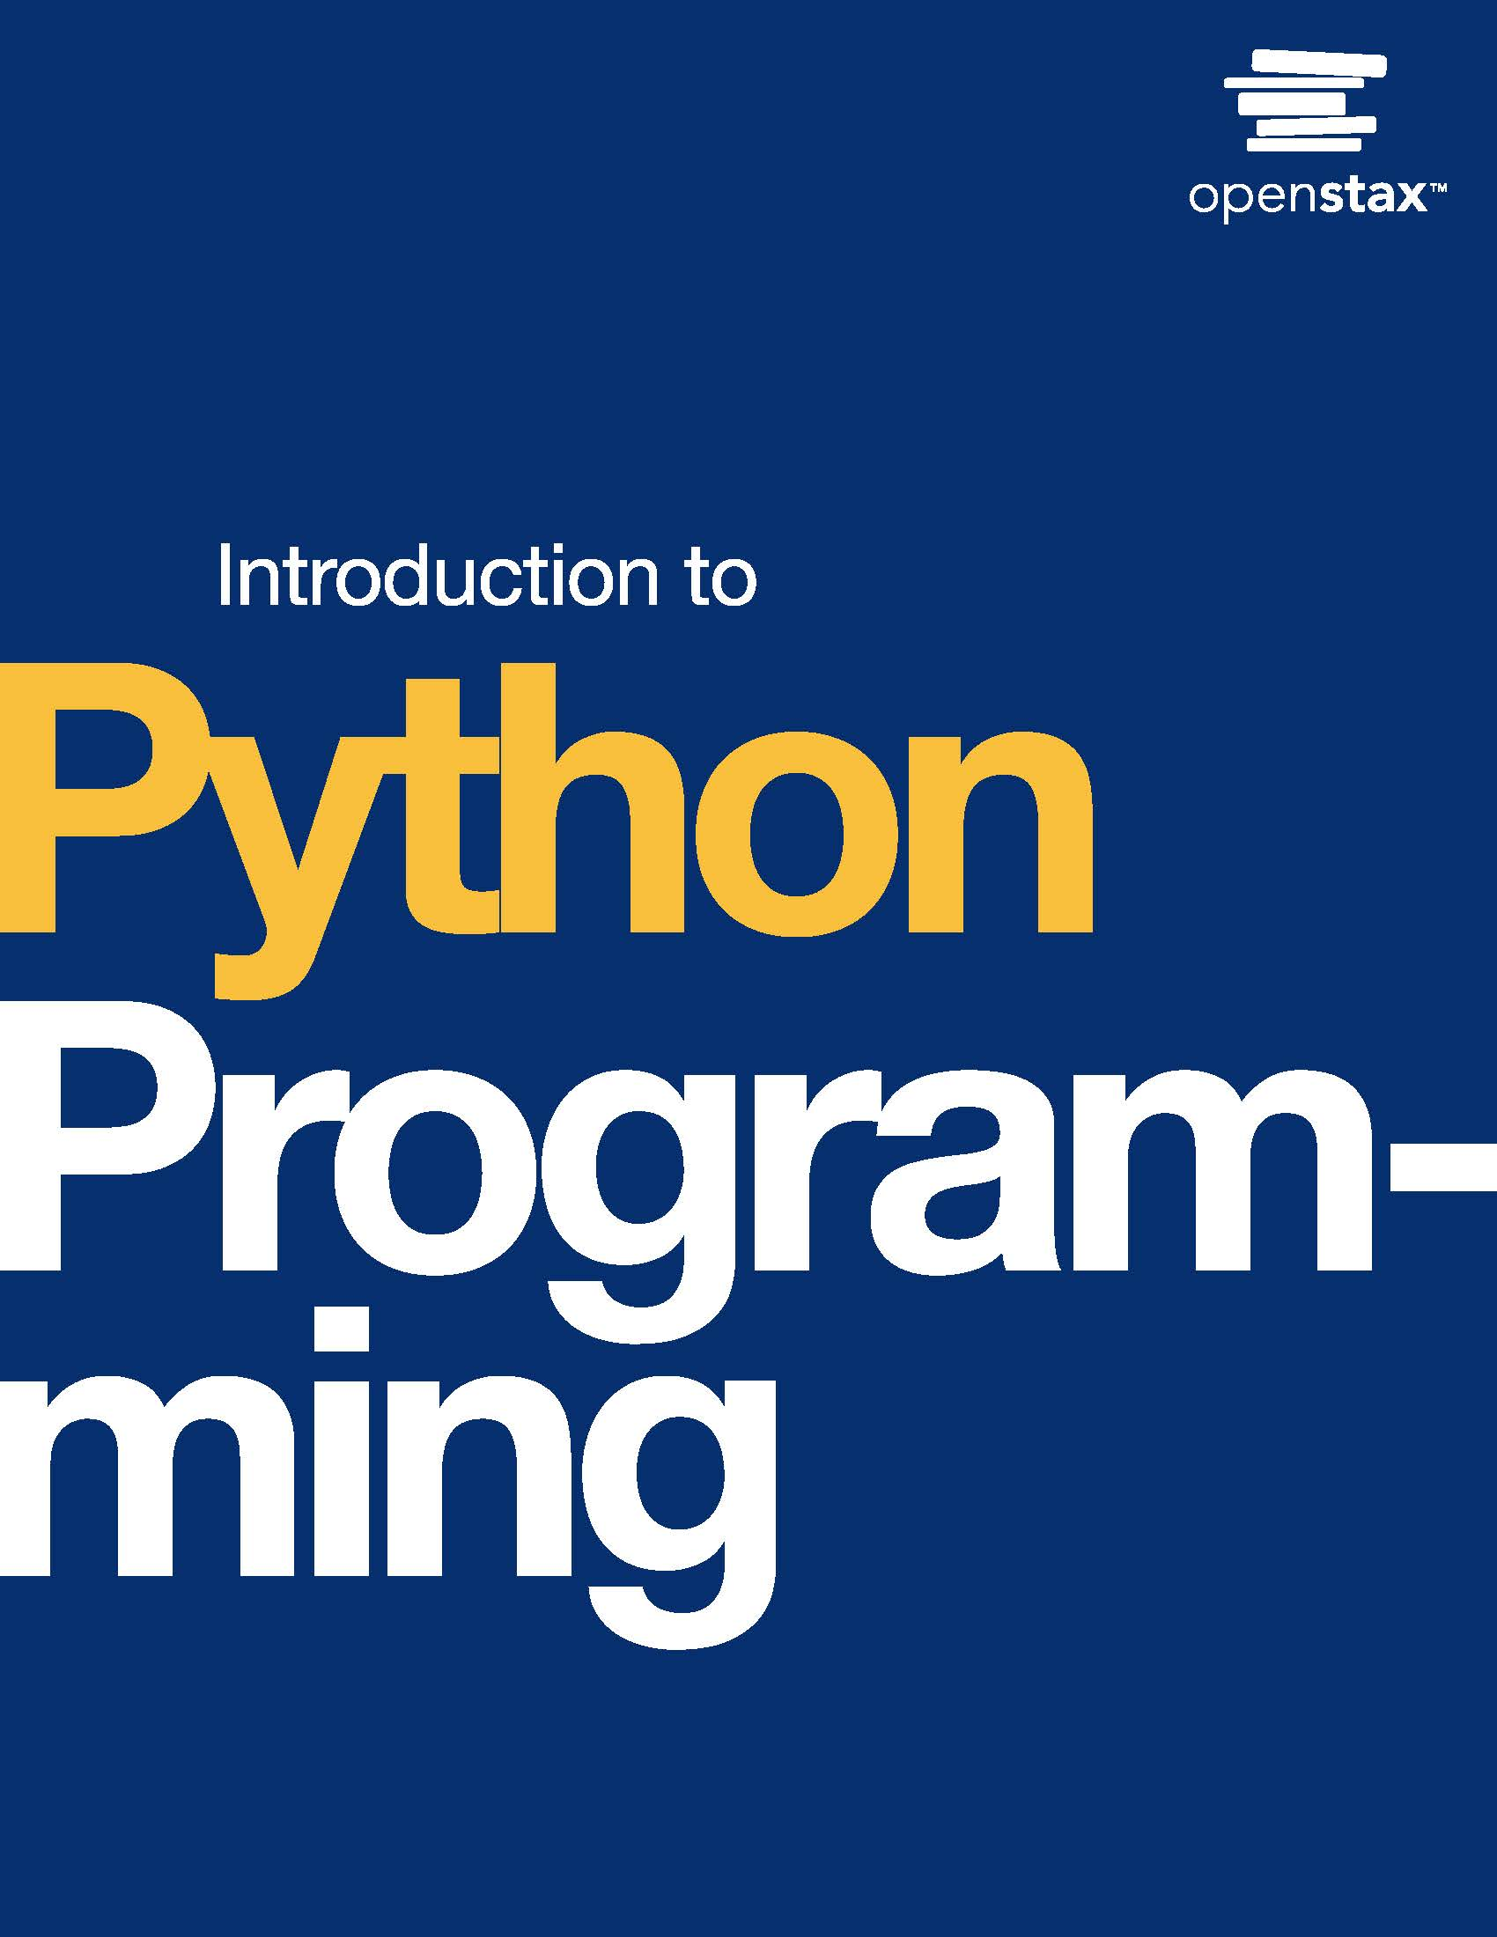
Introduction to Python Programming
Chapter 7: Modules

Slide 2
Chapter outline
Module basics
Importing names
Top-level code
The help function
Finding modules

Slide 3

Figure 7.1
credit: modification of work "Lone Pine Sunset", by Romain Guy/Flickr, Public Domain
Notes:
Landscape photograph of mountains with colors ranging from orange to pink to purple

Slide 4
7.1 Module basics
Learning Objectives
Write a module that consists only of function definitions.
Import the module and use the functions in a program.

Slide 5
7.1 Module basics
Modules are defined by putting code in a .py file. The area module below is in a file named area.py. This module provides functions for calculating area.

Slide 6
7.2 Importing names
Learning Objectives
Import functions from a module using the from keyword.
Explain how to avoid a name collision when importing a module.

Slide 7
7.2 Importing names
Specific functions in a module can be imported using the from keyword:
from area import triangle, cylinderThese functions can be called directly, without referring to the module:
print(triangle(1, 2)) print(cylinder(3, 4))

Slide 8
7.2 Importing names
Name collisions
A name collision occurs when a function is defined multiple times. If a function is defined more than once, the most recent definition is used.
Name collisions may occur when multiple programmers are working on a project
Name collisions are not considered errors and often lead to unexpected behavior.
Selecting specific functions from a module to import reduces the memory footprint; however, importing a complete module can help to avoid collisions because a module.name format would be used.

Slide 9
7.3 Top-level code
Learning Objectives
Identify code that will run as a side effect of importing.
Explain the purpose of if __name__ == "__main__".

Slide 10
7.3 Top-level code
When importing a module, all code in the module is run from top to bottom.
If a module is not designed carefully, unintended code might run as a side effect.
The unintended code is generally at the top level, outside of function definitions.
Python modules often include the statement if __name__ == "__main__" to prevent side effects.
This statement is true when the module is run as a program and false when the module is imported.

Slide 11
7.4 The help function
Learning Objectives
Use the help() function to explore a module's contents.
Identify portions of code included in the documentation.

Slide 12
7.4 The help function
Module documentation
The built-in help() function provides a summary of a module's functions and data. Calling help(module_name) in a shell is a convenient way to learn about a module.

Slide 13
7.4 The help function
Example: Help on functions
The help() function can be called on specific functions in a module. Open a Python shell on your computer, or use the one at python.org/shell. Type the following lines, one at a time, into the shell.
import random
help(random.randint)
help(random.choice)
import statistics
help(statistics.median)
help(statistics.mode)
Remember to use the navigation keys on the keyboard, and press the Q key ("quit") to return to the Python shell.

Slide 14
7.5 Finding modules
Learning Objectives
Explain differences between the standard library and PyPI.
Search python.org and pypi.org for modules of interest.

Slide 15
7.5 Finding modules
The Python Standard Library is a collection of built-in functions and modules that support common programming tasks.
Ex: The math module provides functions like sqrt() and constants like pi.
Python's official documentation includes a library reference and a module index for becoming familiar with the standard library.

Slide 16
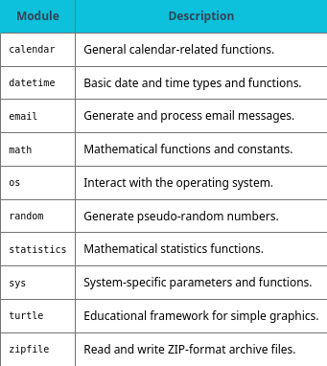
Table 7.1 Example built-in modules in the standard library.

Slide 17
7.5 Finding modules
Third-party modules
The Python Package Index (PyPI), available at pypi.org, is the official third-party software library for Python.
The abbreviation "PyPI" is pronounced like pie pea eye (in contrast to PyPy, a different project).
PyPI allows anyone to develop and share modules with the Python community.
Most software available on PyPI is free and open source.

Slide 18
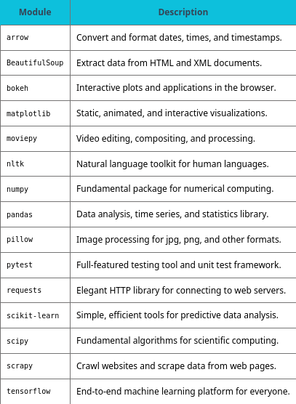
Table 7.2 Example third-party modules available from PyPI.

Slide 19
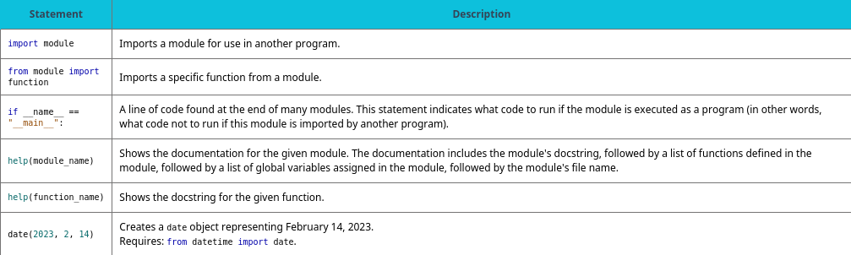
Table 7.3 Chapter 7 reference.

